Slide 1


Can Eniac cooperate with Magist marketplace?

Slide 2
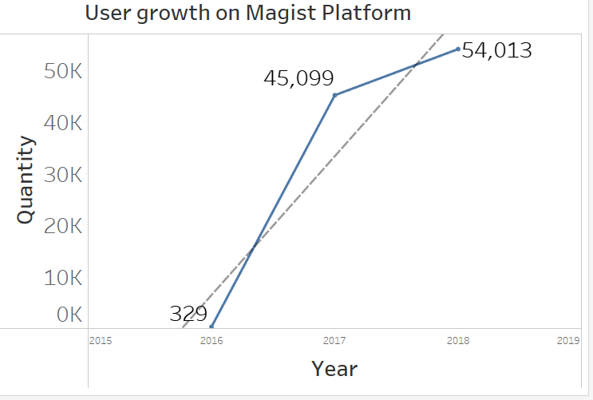
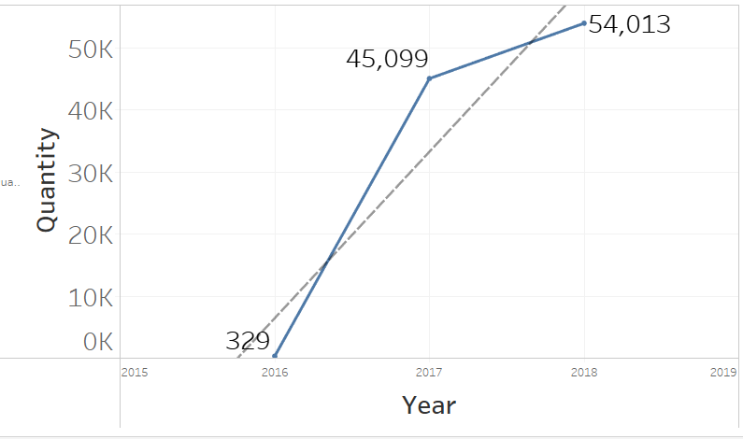
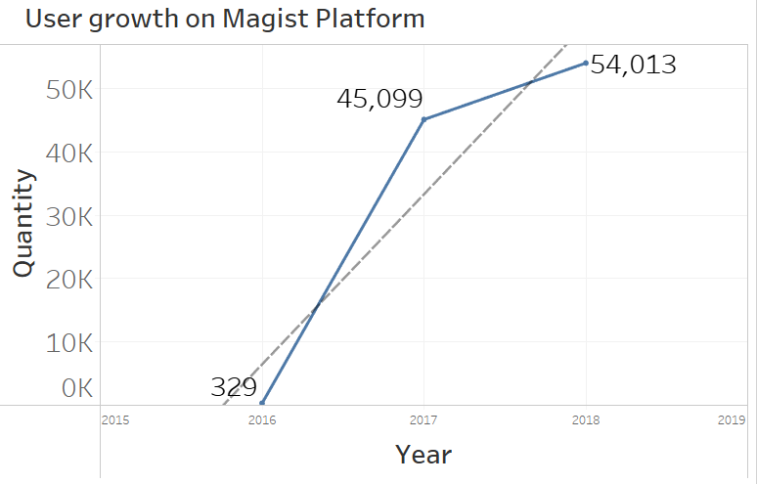
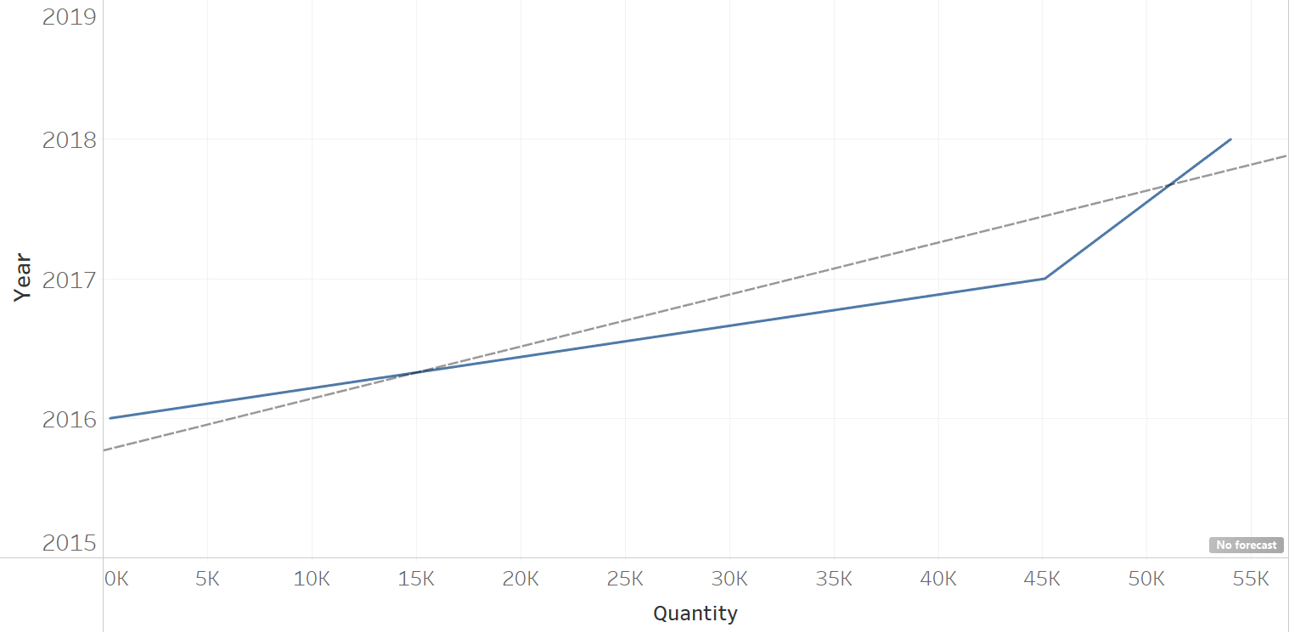
Increase in Magist User Growth

Slide 3
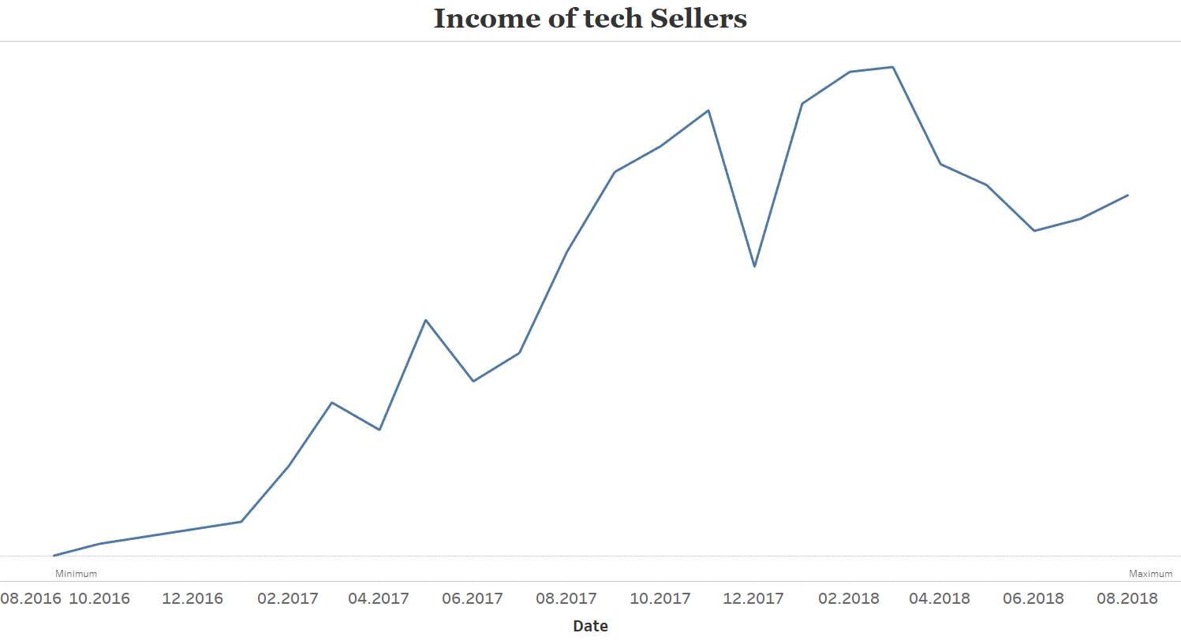
Avg Eniac monthly revenue: > 1MLN€
100K€

Slide 4

Order delivered in LESS than 13 days
Average delivery time:
March 2020: 21 days
May 2020: 16 days
(Statista)

Slide 5

DELIVERIES
93%
ON TIME
7% DELAYED

Slide 6
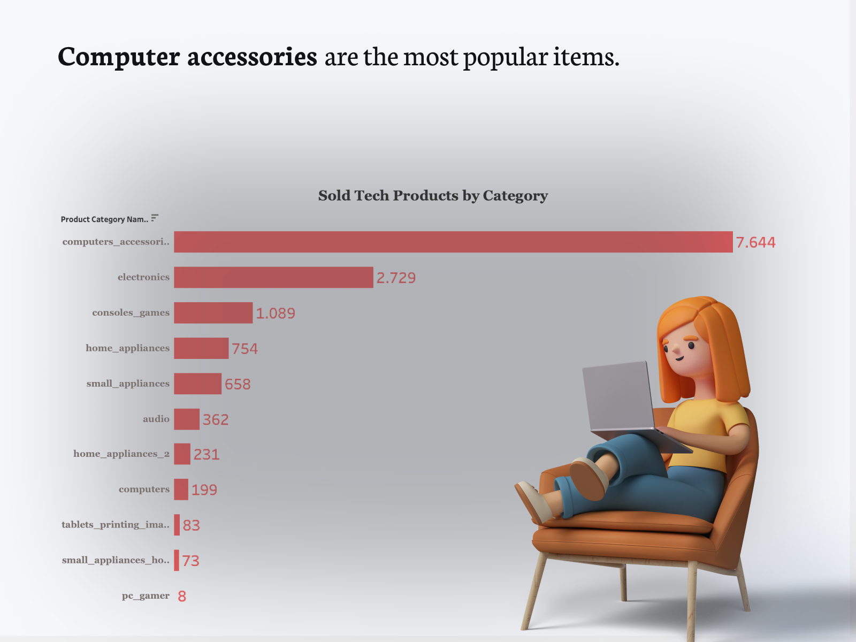
Notes:
Based on group category counts, Magists’ high demand for tech accessories is a good fit for Eniac’s Apple accessory perspective.

Slide 7
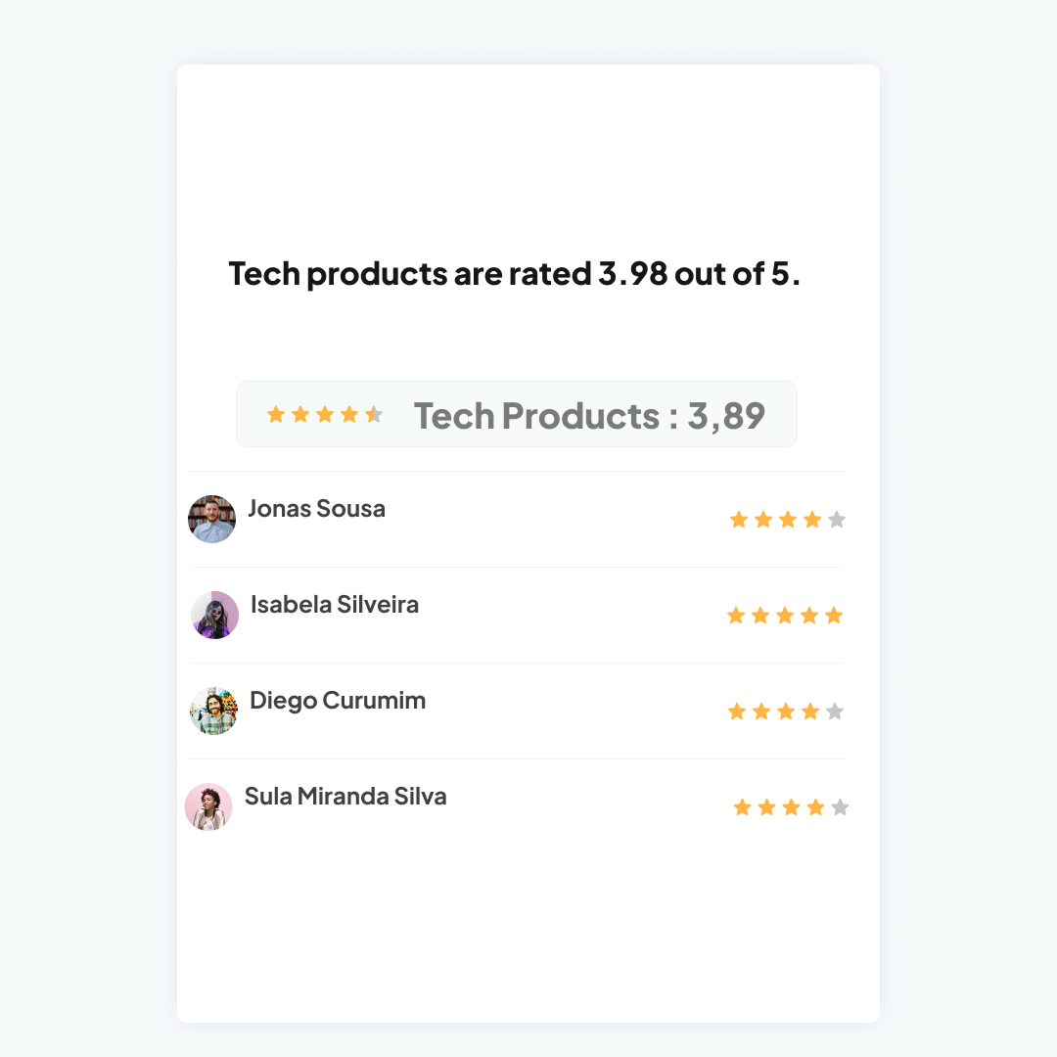
Notes:
On the other hand, the customer rated tech products at 3.98 out of 5, which is still concerning because the ratings were the same for non-tech products. So the users and their reviews don’t seem promising.

Slide 8
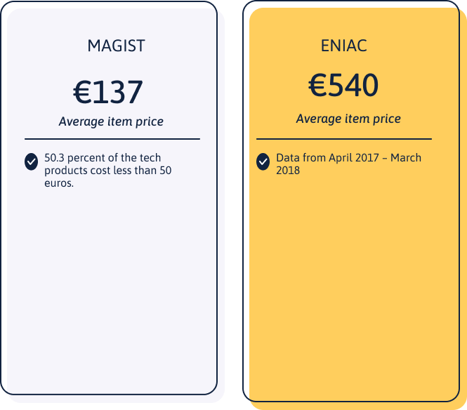
Notes:
Another critic point is: According to the comparison of average tech product prices per item, Magist has lower capital than Eniac. When you think that the average income of people in brazil is 441 euros in 2018, it seems that being team up with Magist is not the ideal choice.

Slide 9

Key takeaways
High demand in computer accessories
Magist User growth
Gap between average item price
Fair ratings on tech products
Periodic increase and decrease in seller’s income
Faster (25% in n days) and on time delivery
Notes:
However, product quality and other factors like crisis might influence the upcoming predictions of Magist Marketplace.

